Slide 1

Reception Maths
Parents’ Workshop
Enjoy, Aspire, Achieve
Notes:
This is an introduction to helping your child develop as a mathematician during Reception.

Slide 2
Today’s Aims
To help you to understand how mathematics fits into the Early Years Foundation Stage Curriculum
Explain what maths teaching and learning looks like within Reception
To share some ideas of how you can help your child with their maths
Notes:
Introduce

Slide 3
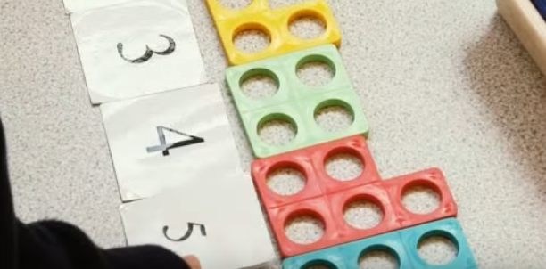
Maths – an abstract concept
Notes:
Some of you might have come because
You think maths has changed since you were at school – and you’re right it has in some ways
Some may have come because you didn’t enjoy maths at school, you feel like you’re not any good at it and you don’t want your child to feel the same way - I’m so pleased youre here too.
We hear parents say to their ch I’m not good at Maths but we don’t hear them say I’m not very good at reading or writing. Telling them this (even) if you’re feeling it on the inside lets them know that its ok not to be good at it – that its something a bit scary that they might not be able to do.
Maths for alot of people is a scary idea – that they’ll be put on the spot on the spot to answer something that they may not be able to work out – people describe a brain freeze.
Let’s have a look at why ch may feel this way:
VIDEO CLIP - 2MINS
“With greater confidence comes deeper understanding and higher levels of achievement”

Slide 4
What makes
a good mathematician?
Number
facts
Problem solvers
Conceptualise understanding
Generalise
Perseverance
Risk-takers
Challenge
Vocabulary
Think mathematically
Use and
apply skills and knowledge
Fluent Calculators
What makes a good mathematician?
Notes:
What makes a good mathematician?
As teachers we’ve thought about the qualities we’ve found our good mathematician have.
Good news is these can all be learned

Slide 5
Early Learning Goals
Children at the expected level of development will:
Have a deep understanding of number to 10, including the composition of each number;
Subitise (recognise quantities without counting) up to 5;
- Automatically recall (without reference to rhymes, counting or other aids) number bonds up to 5 (including subtraction facts) and some number bonds to 10, including double facts.
Notes:
- Shape, Space and Measure includes
Our teaching encompasses 3 strategies to enable all learners to access it:
visual – to help ch picture what numbers mean,
audial– listening and talking about number, discussing why they think an idea my be correct and how they know and kinesthestic – practically solving calulations and problems using supporting materials – numicon, tens and units blocks, counters, coins, tens frames.

Slide 6
Numerical Patterns ELG
Children at the expected level of development will:
12
- Verbally count beyond 20, recognising the pattern of the counting system;
- Compare quantities up to 10 in different contexts, recognising when one quantity
is greater than, less than or the same as the other quantity;
- Explore and represent patterns within numbers up to 10, including evens and
odds, double facts and how quantities can be distributed equally.

Slide 7
How is mathematical learning achieved?
Daily maths lessons
  Mental Maths activities
  Whole-class teaching (10 – 15 mins per day)
  Small focus-group teaching
Cross-curricular learning
  Link to themes and stories
  Helps builds connections and understanding
During child-initiated learning
  COOL time
  Opportunity to practise and rehearse in own contexts
  Opportunity to work with focus groups to improve understanding
Notes:
Our daily maths lessons include
1.Mental maths activities – practising countig and rehearsing simple calculation startegies
2.Whole class teaching
Teachers plan together to introduce and teach key concepts consistently across the yr grp
• Children work together to develop not only their mathema+cs abili+es, but general listening and attention skills
• Allows teachers to teach and model skills, concepts and language and to assess where more support may be needed
We continue this during small focus group activities with T and Tas as Adult-led Play
• Allows adults to model mathematical skills and introduce concepts
• Adults can focus on speciﬁc aspects of learning and address misconceptions
• Adults can demonstrate and encourage the use of mathematical language
To support ch understanding and to help them make connections we use books and ideas reating to our theme.
During COOL time (child-initiated learning)
child-initiated learning (COOL time)
Children choose their own mathematical learning
• Allows children to explore different approaches and reach conclusions themselves
• It allows them to practice skills and language in a safe and personal way
• Encourages critical thinking, problem solving and perseverance

Slide 8
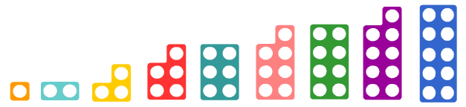
Materials we use to support understanding
Numicon
Counters (blocks, buttons, shells, cars, toy people, lolly sticks)
Tens frames
Number lines
Coins

Slide 9
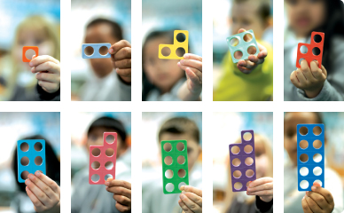
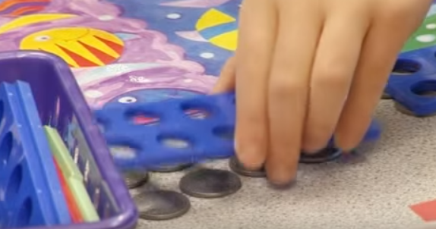
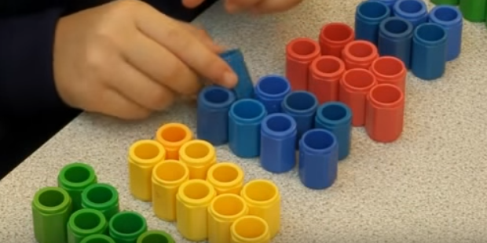
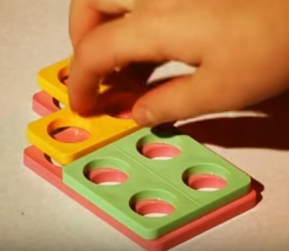
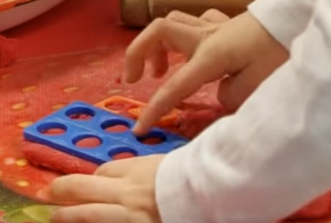
Numicon
Uses a sequence of shapes
Provides images for numbers
Notes:
Numicon uses a sequence of shapes,
Providing images for numbers
Helping ch build their understanding
This pattern and relationship between number helps ch build their understanding of what numbers mean.
Ch like working with numicon because it helps them
This helps them see how numbers work : it takes the abstract idea of a number and makes it real.
It plays to their strong sense of pattern
Helps ch see how numbers work

Slide 10
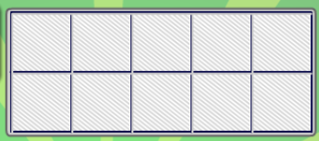

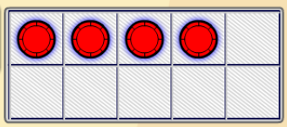
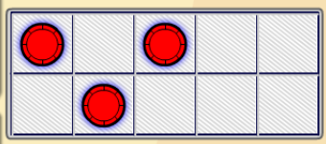
Ten Frames
Build a mental picture of what each amount looks like.
Supports counting, calculating and fact recognition E.G. number bonds to 10.
How many more?
Notes:
Tens frames
Introducing these at the moment. Evidence shows that using thses help ch to build a mental picture of what a number looks like and can help with simple calculations.
We start by getting ch to count number of spaces on top, the bottom row, then totoal number of spaces = 10.
Red rectangle - Then they match the frame shown to them using counters and a frame converting what they’ve seen to doing it (usually with partner)– the counting how many are full? how many are empty?In this example there are 4 counters. Ch quickly start to know this because there is 1 space left on the top line and nothing below.
They then find that 5 spaces (all of the bottom line + 1 of the top line ) = 6 left over.
4 + 6 = 10
The example in the yellow box is a game we play building ch number recognition skills. Id quickly show my tens frame with a few counters, then hide my frame. The ch have to remember the amount of counters I’ve used and place their counters correctly to match mine.
With practise this builds the ch knowledge of what ‘3’ looks like sowhen they are counting practcially they do’t have to begin at 1 everytime – part of getti ng the Year 1 ready.

Slide 11
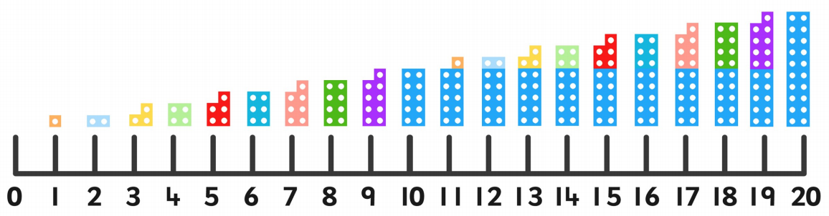
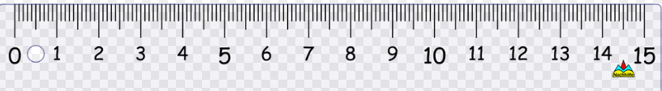
Number lines
Ordering
Counting on and counting back
Addition and subtraction
Recognising and writing numerals
Notes:
NUMBER LINES
Read
Ideas on supporting materials on the table

Slide 12
How you can help your child become a keen mathematician
  Talk about number
  Share your everyday maths
  Numicon
  Mental maths
  Tapestry
  Number work books
  Keep it fun
Notes:
Talk about numbers in everyday lives
Spot them when out
What comes next? What comes before – how do you know? Why?
Use the numicon shapes and ideas from the support materials sheet (SHOW)
Bake
Talk about the time (laters, earlier, today, tomorrow, yesterday) as well as its 7 o’clock so its time for bed.
Practise counting steps, number of cars
Continue to use observations on Tapestry to talk about your child’s learning they have been doing at school . We love to share
After xmas we’ll start to send home Numberwork books
Can pick and choose which activity. Try 1 per week.
KEEP IT FUN

Slide 13
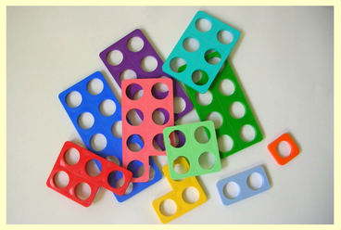
Let’s play
Notes:
Ways to make ...
Find 1 more than ... 1 less than...
Order the pieces from smallest to largest?

Slide 14
Notes:
Thank you for coming today.
Please complete an evaluation form.

Slide 15
How you can help your child become a keen mathematician
say counting rhymes and songs
count objects
make number lines and number tracks and use them in games (see over)
play board games like snakes and ladders and skittle games
make repeating patterns with toys e.g. parking vehicles car, bus, car, bus…
play ‘I spy’ games with numbers and shapes
make and talk about shapes with playdough, finding out and describing how the shape can be lengthened, shortened, widened, etc.
fill spoons, bags, etc. and talk about them being full, empty, half full
let your child handle money, sort and name coins, make amounts and give change.
Most importantly, talk to your child about maths. Ask ‘why?’, ‘what?’ and ‘how?’ questions to encourage mathematical thinking.
Notes:
ELG for maths comprise of 2 strands
Number
- Shape, Space and Measure

Slide 16
How does maths fit into the
Early Years Foundation stage?
• The prime areas of learning:
  - communication and language
  - physical development
  - personal, social and emotional development
• The speciﬁc areas of learning:
  literacy
  mathematics
  understanding the world
  expressive arts & design
Notes:
The EYFS curriculum is split into 2 sections
Prime areas –
Specific – although maths is a specific area of learning the ch need skills from the prime areas to be succesful – to be able to explain what they have drawn or how they have used the materials, to be able to make

